Slide 1

IOTS
Timothy Leong Ming Liang (P1907799)
Ron Tan Zi Yu (P1908521)
Tiamzon Joseph Martin (P1907492)

Slide 2

Table of contents
Problem Statement
Solution
System Design
Hardware Design
TR64 Compliances
Attack Surfaces
Mitigation Techniques
Live Demo

Slide 3

Problem
Common issues with traditional key and lock system
Require users to bring a key
Possibility of losing their key
Difficult to share their key
Difficult to change their lock

Slide 4
solution
Central management system
Password based authentication
Cloud system
A website to manage their door lock system
Usage of a keypad and LCD to type in a password in a tamper-proof enclosure
We will make use of Cloud systems for the Central Management System

Slide 5


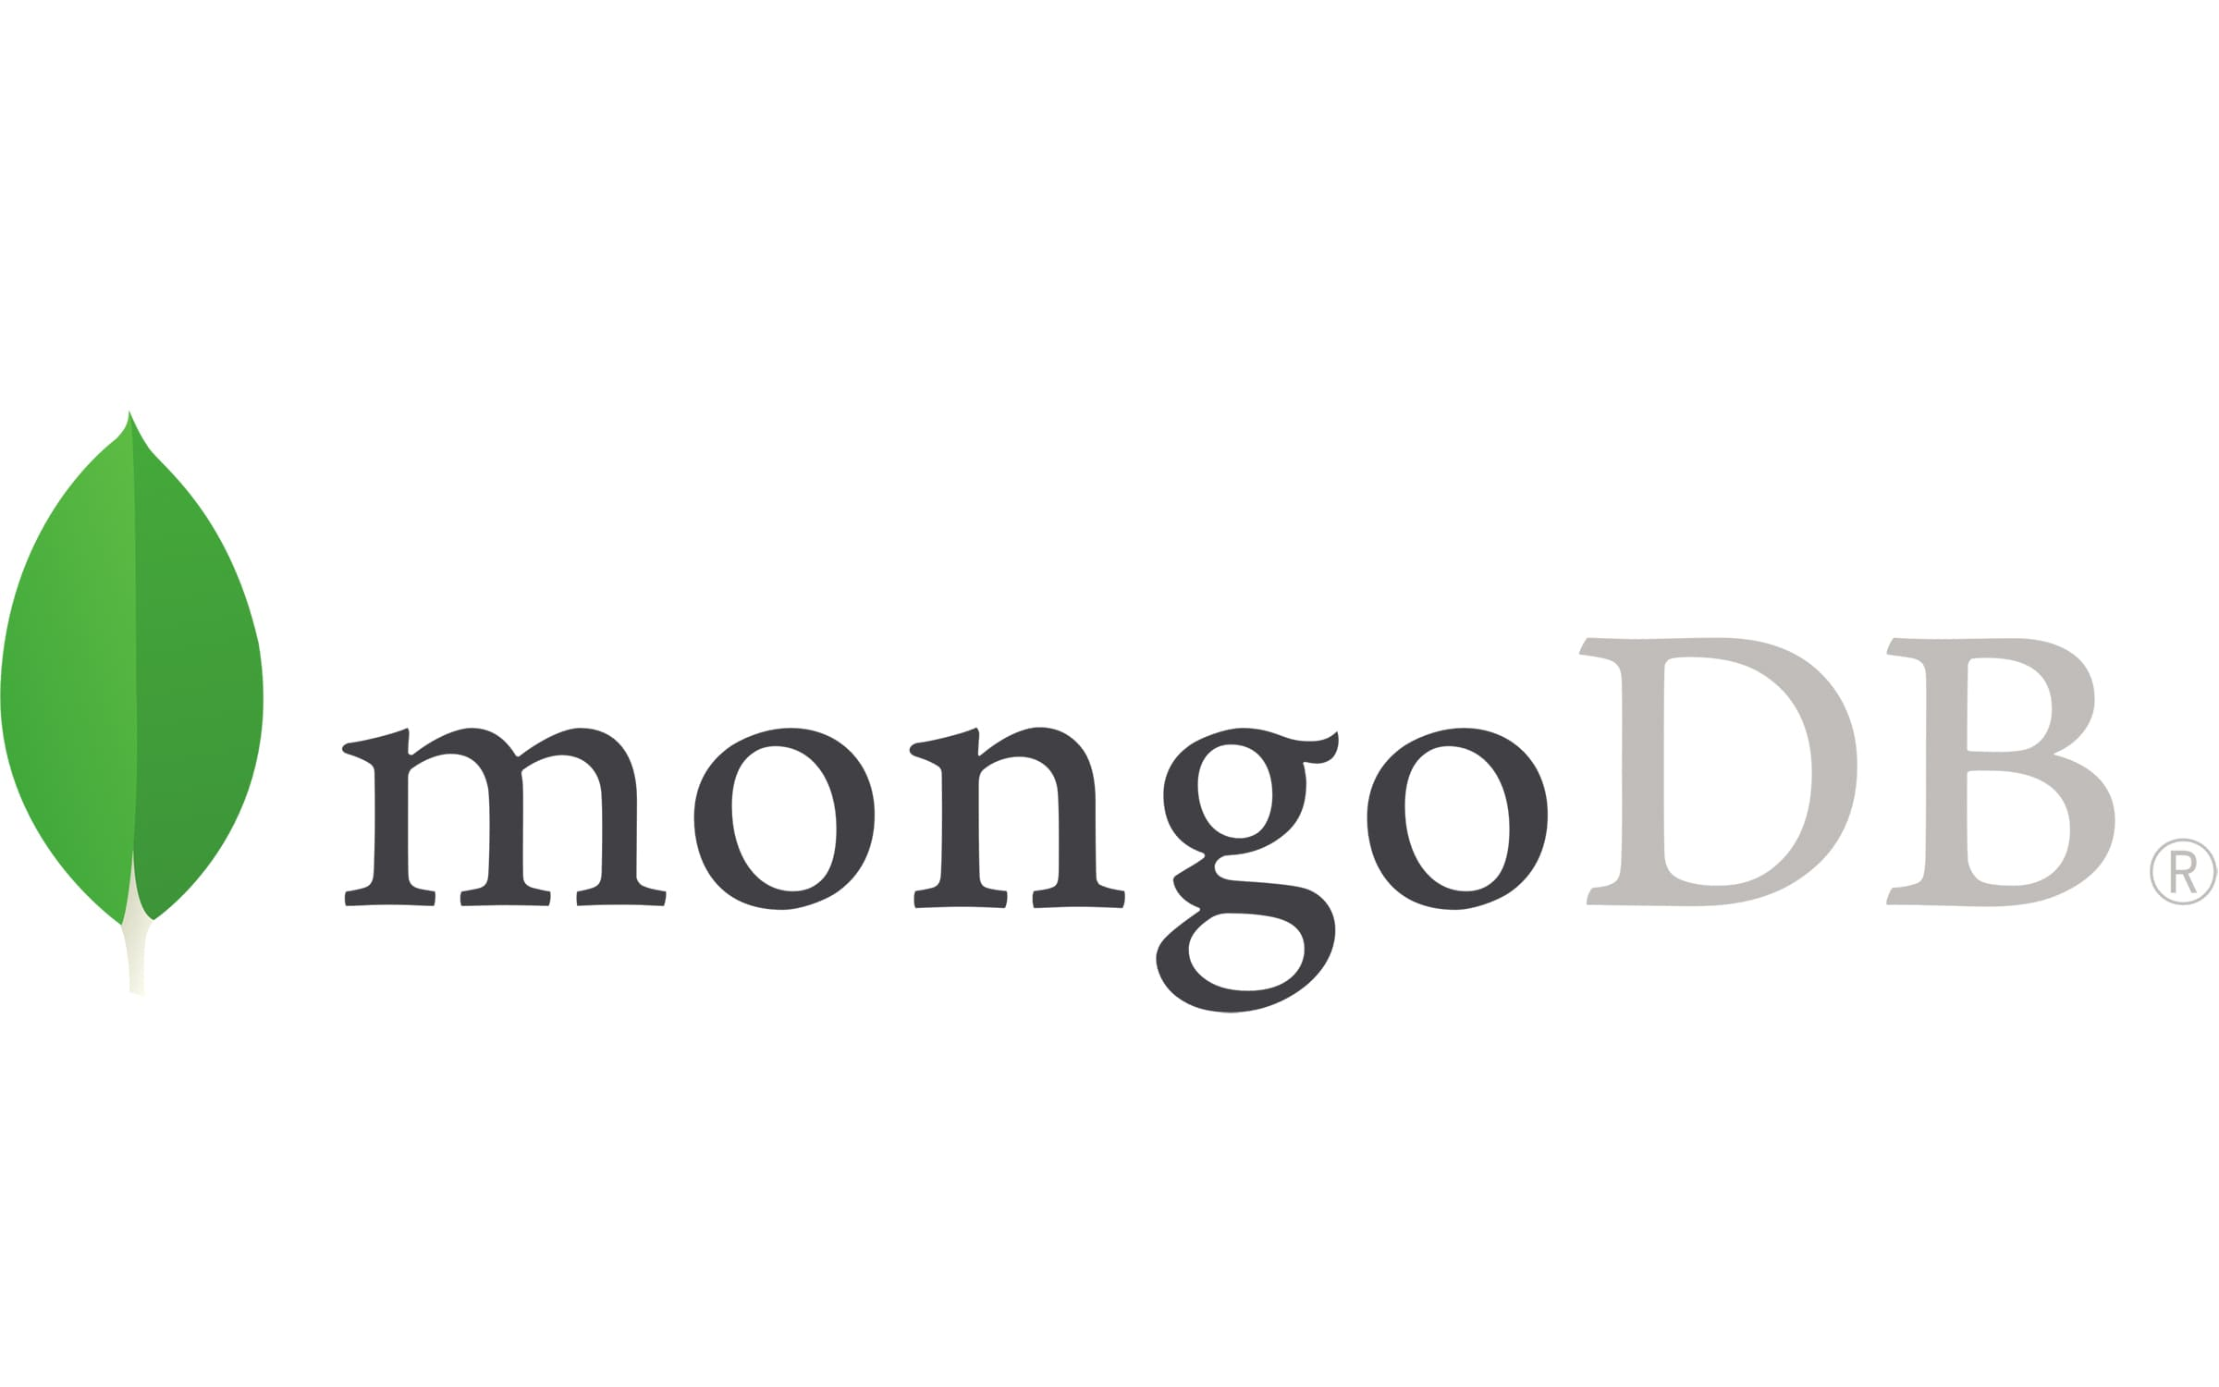
Cloud providers
Mongodb
easy horizontal and vertical scalability
Automatic logging of events
Enterprise level security
Vercel
Provides high availability for our website
Secure storage of environment variables
Usage of HTTPS/TLS for deployed websites
Auth0
Advance authentication security features
OAuth 2.0

Slide 6
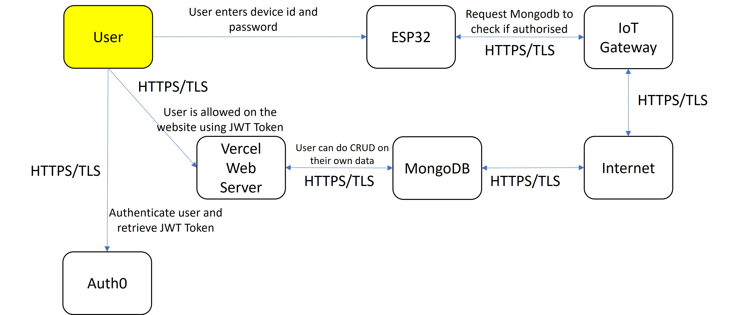
HOW IT WORKS

Slide 7
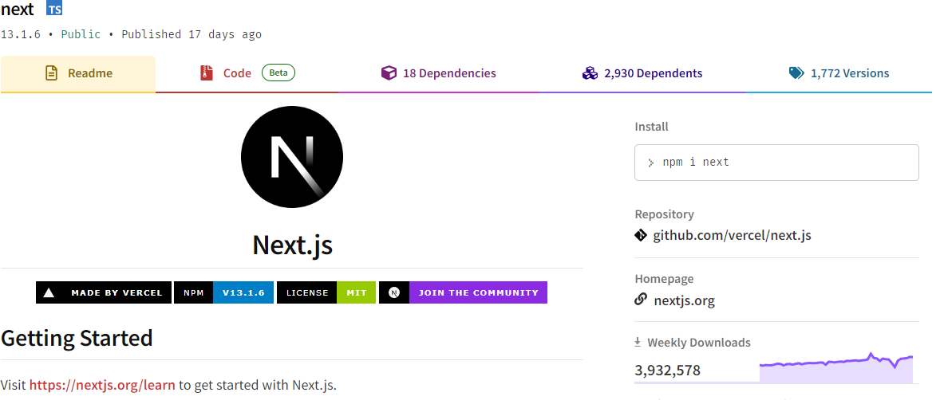
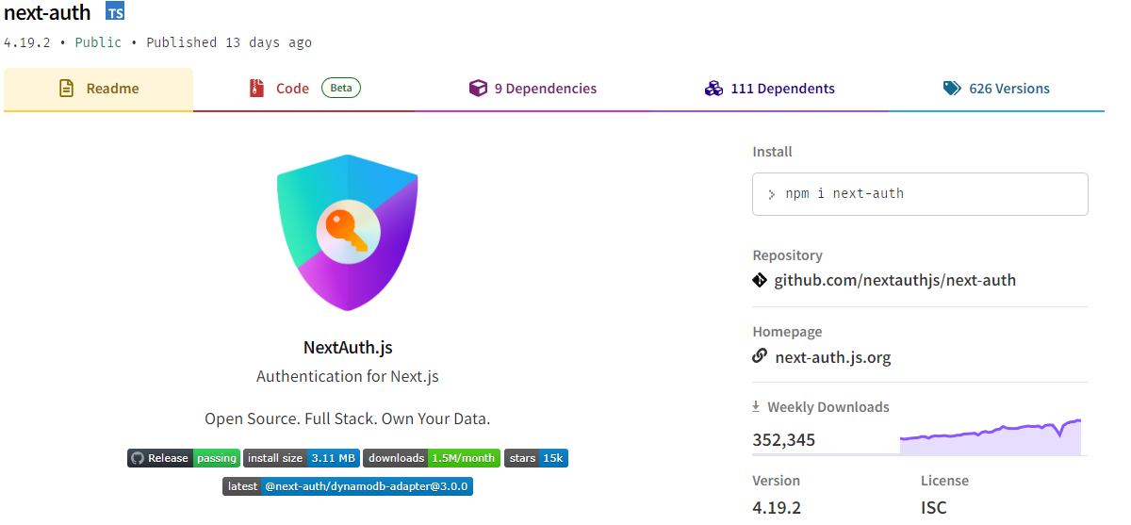
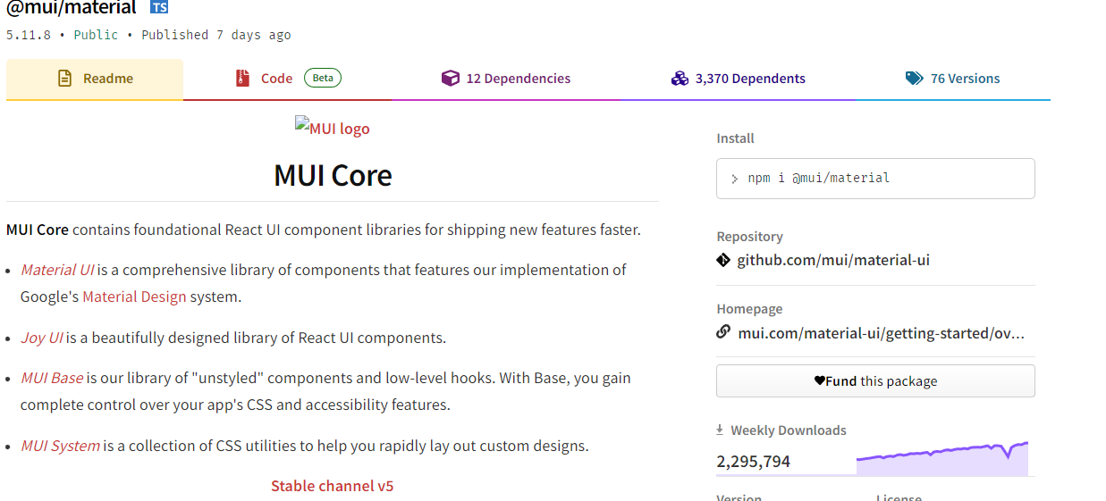
WEbsite
nextjs
Most popular ReactJS framework for full stack applications
Next-auth
Most popular NextJS package for securing NextJS applications
MUI
Most popular design library for ReactJS

Slide 8
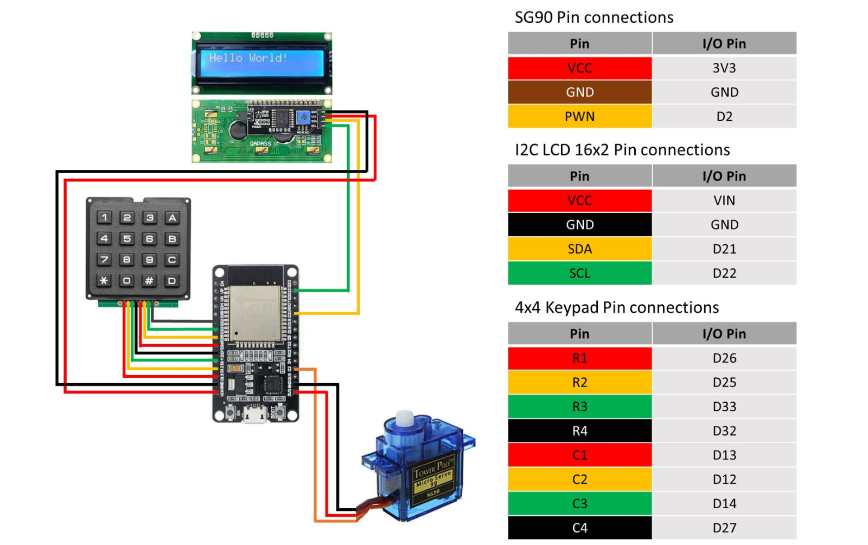
hardware
esp32
4X4 keypad
I2C LCD
SG90 SERVO

Slide 9

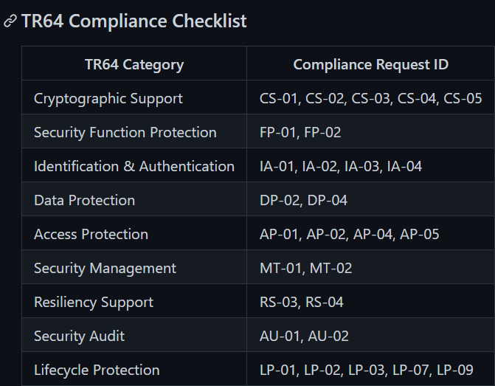
TR64 Compliance

Slide 10
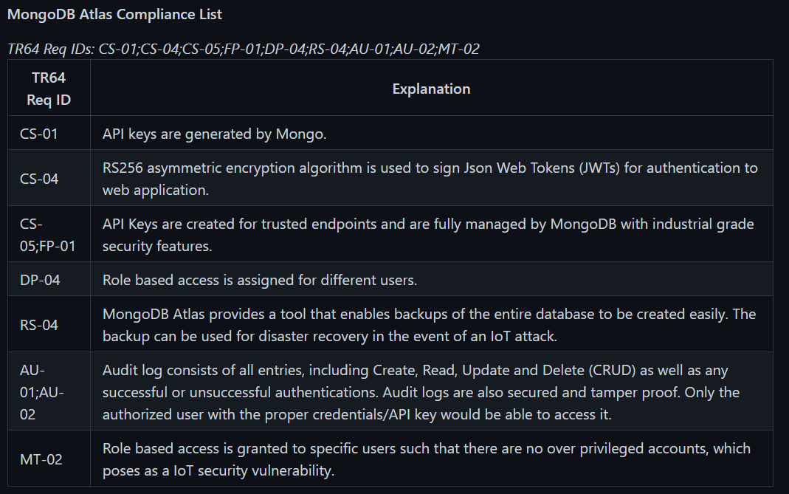
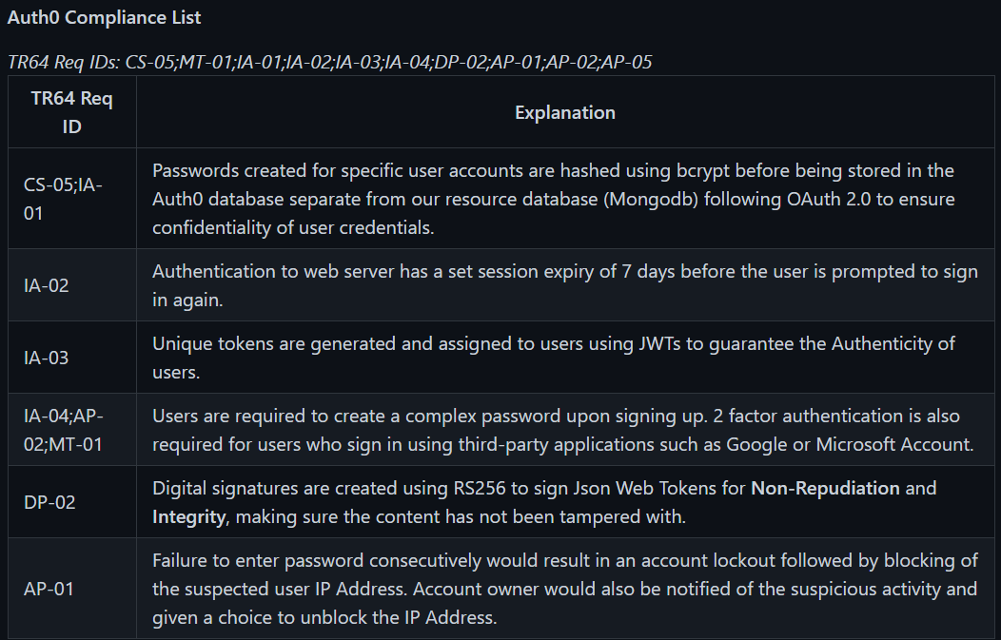
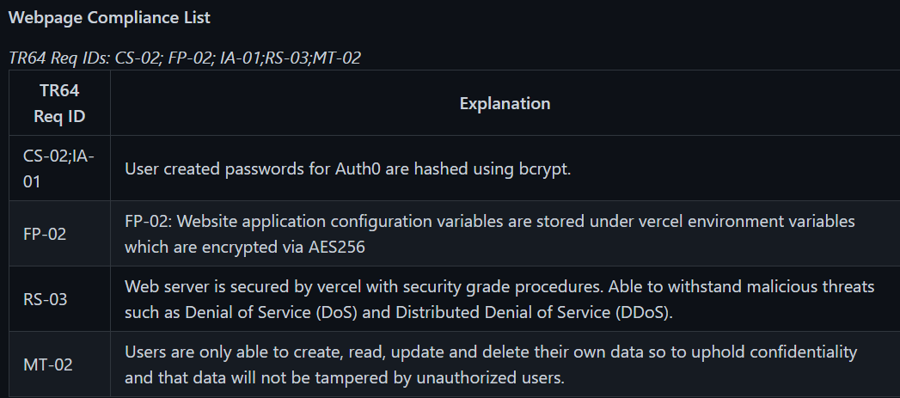
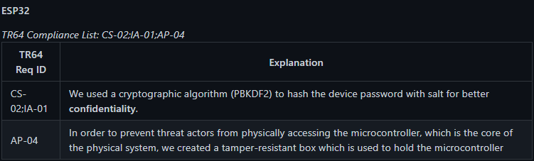
Notes:
w3

Slide 11
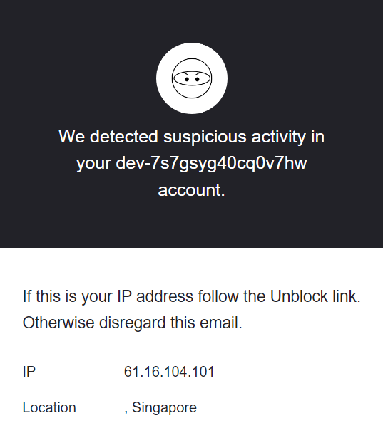
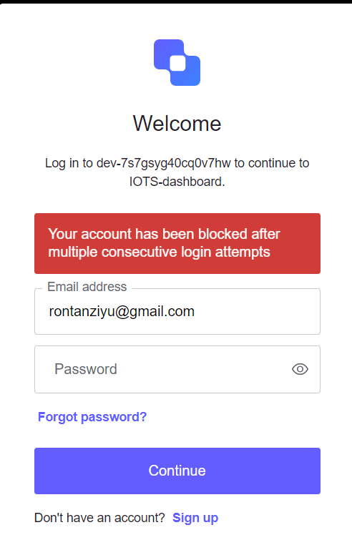
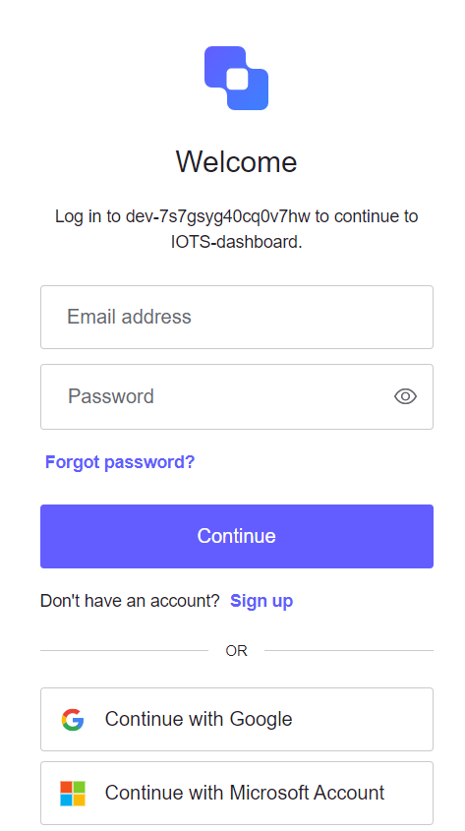
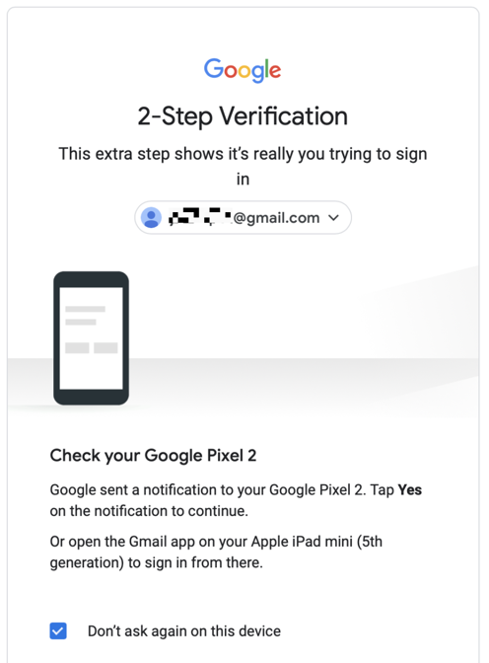
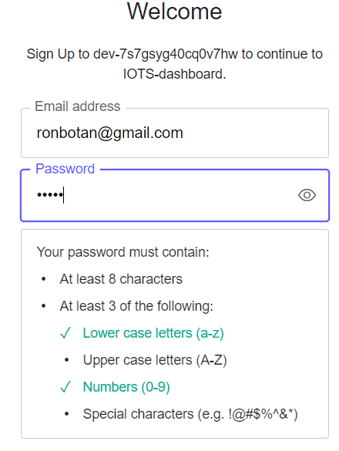
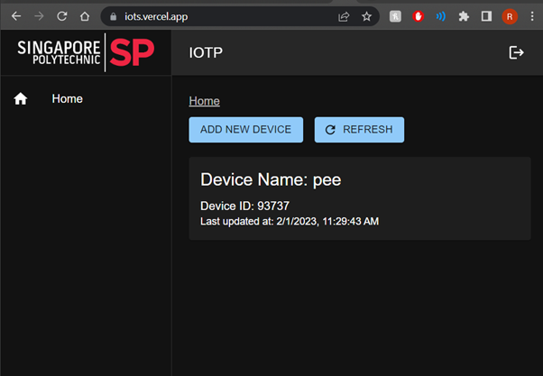
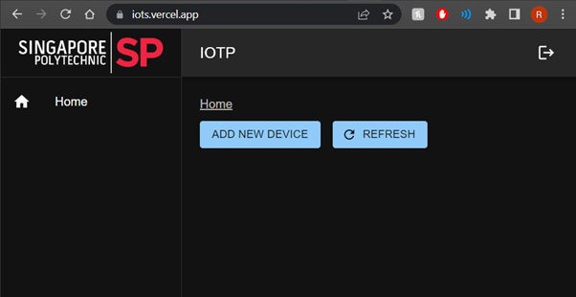
Notes:
w3

Slide 12
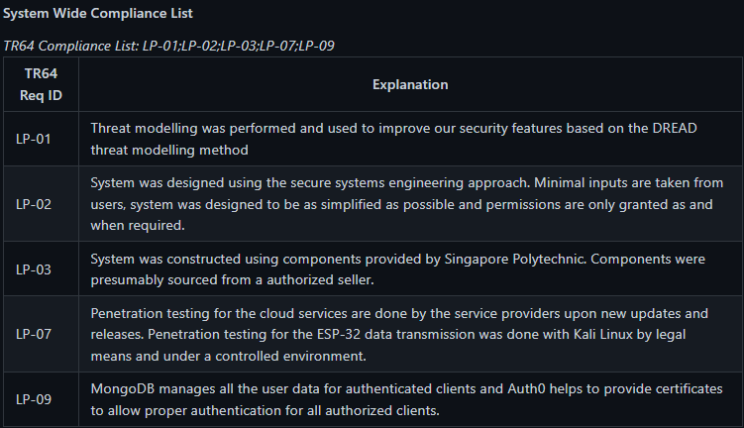
Lifecycle protection

Slide 13
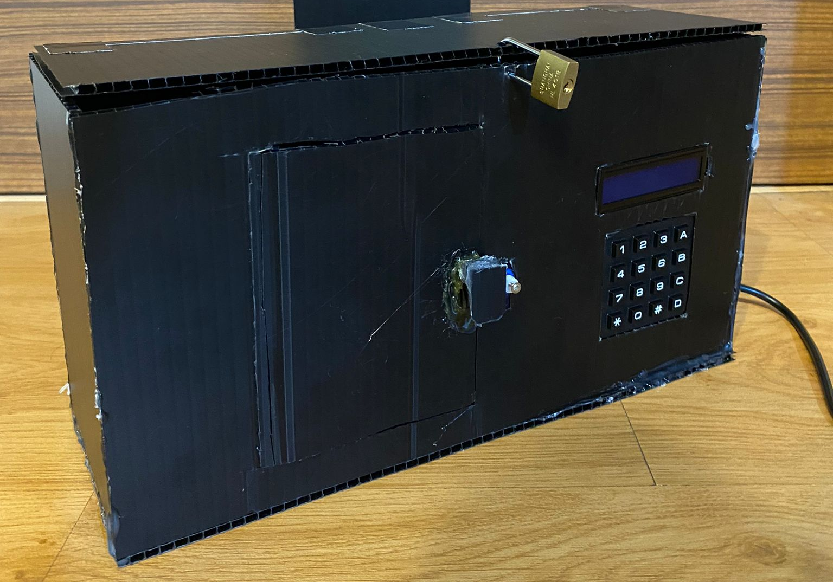
Physical Attacks
vulnerabilities
dread
Physically tampering of the Smart Door System and injecting of external code into the microcontroller
Damage – High
Reproducibility – High
Exploitability – Middle
Affect Users – Low
Discoverability – Low
mitigation
In order to mitigate such attacks, we created a tamper proof enclosure for the microcontroller of the Smart Door System. This would make it such that random people will not be able

Slide 14
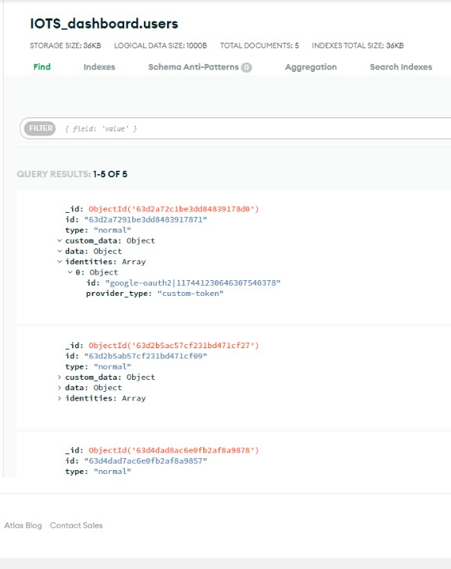
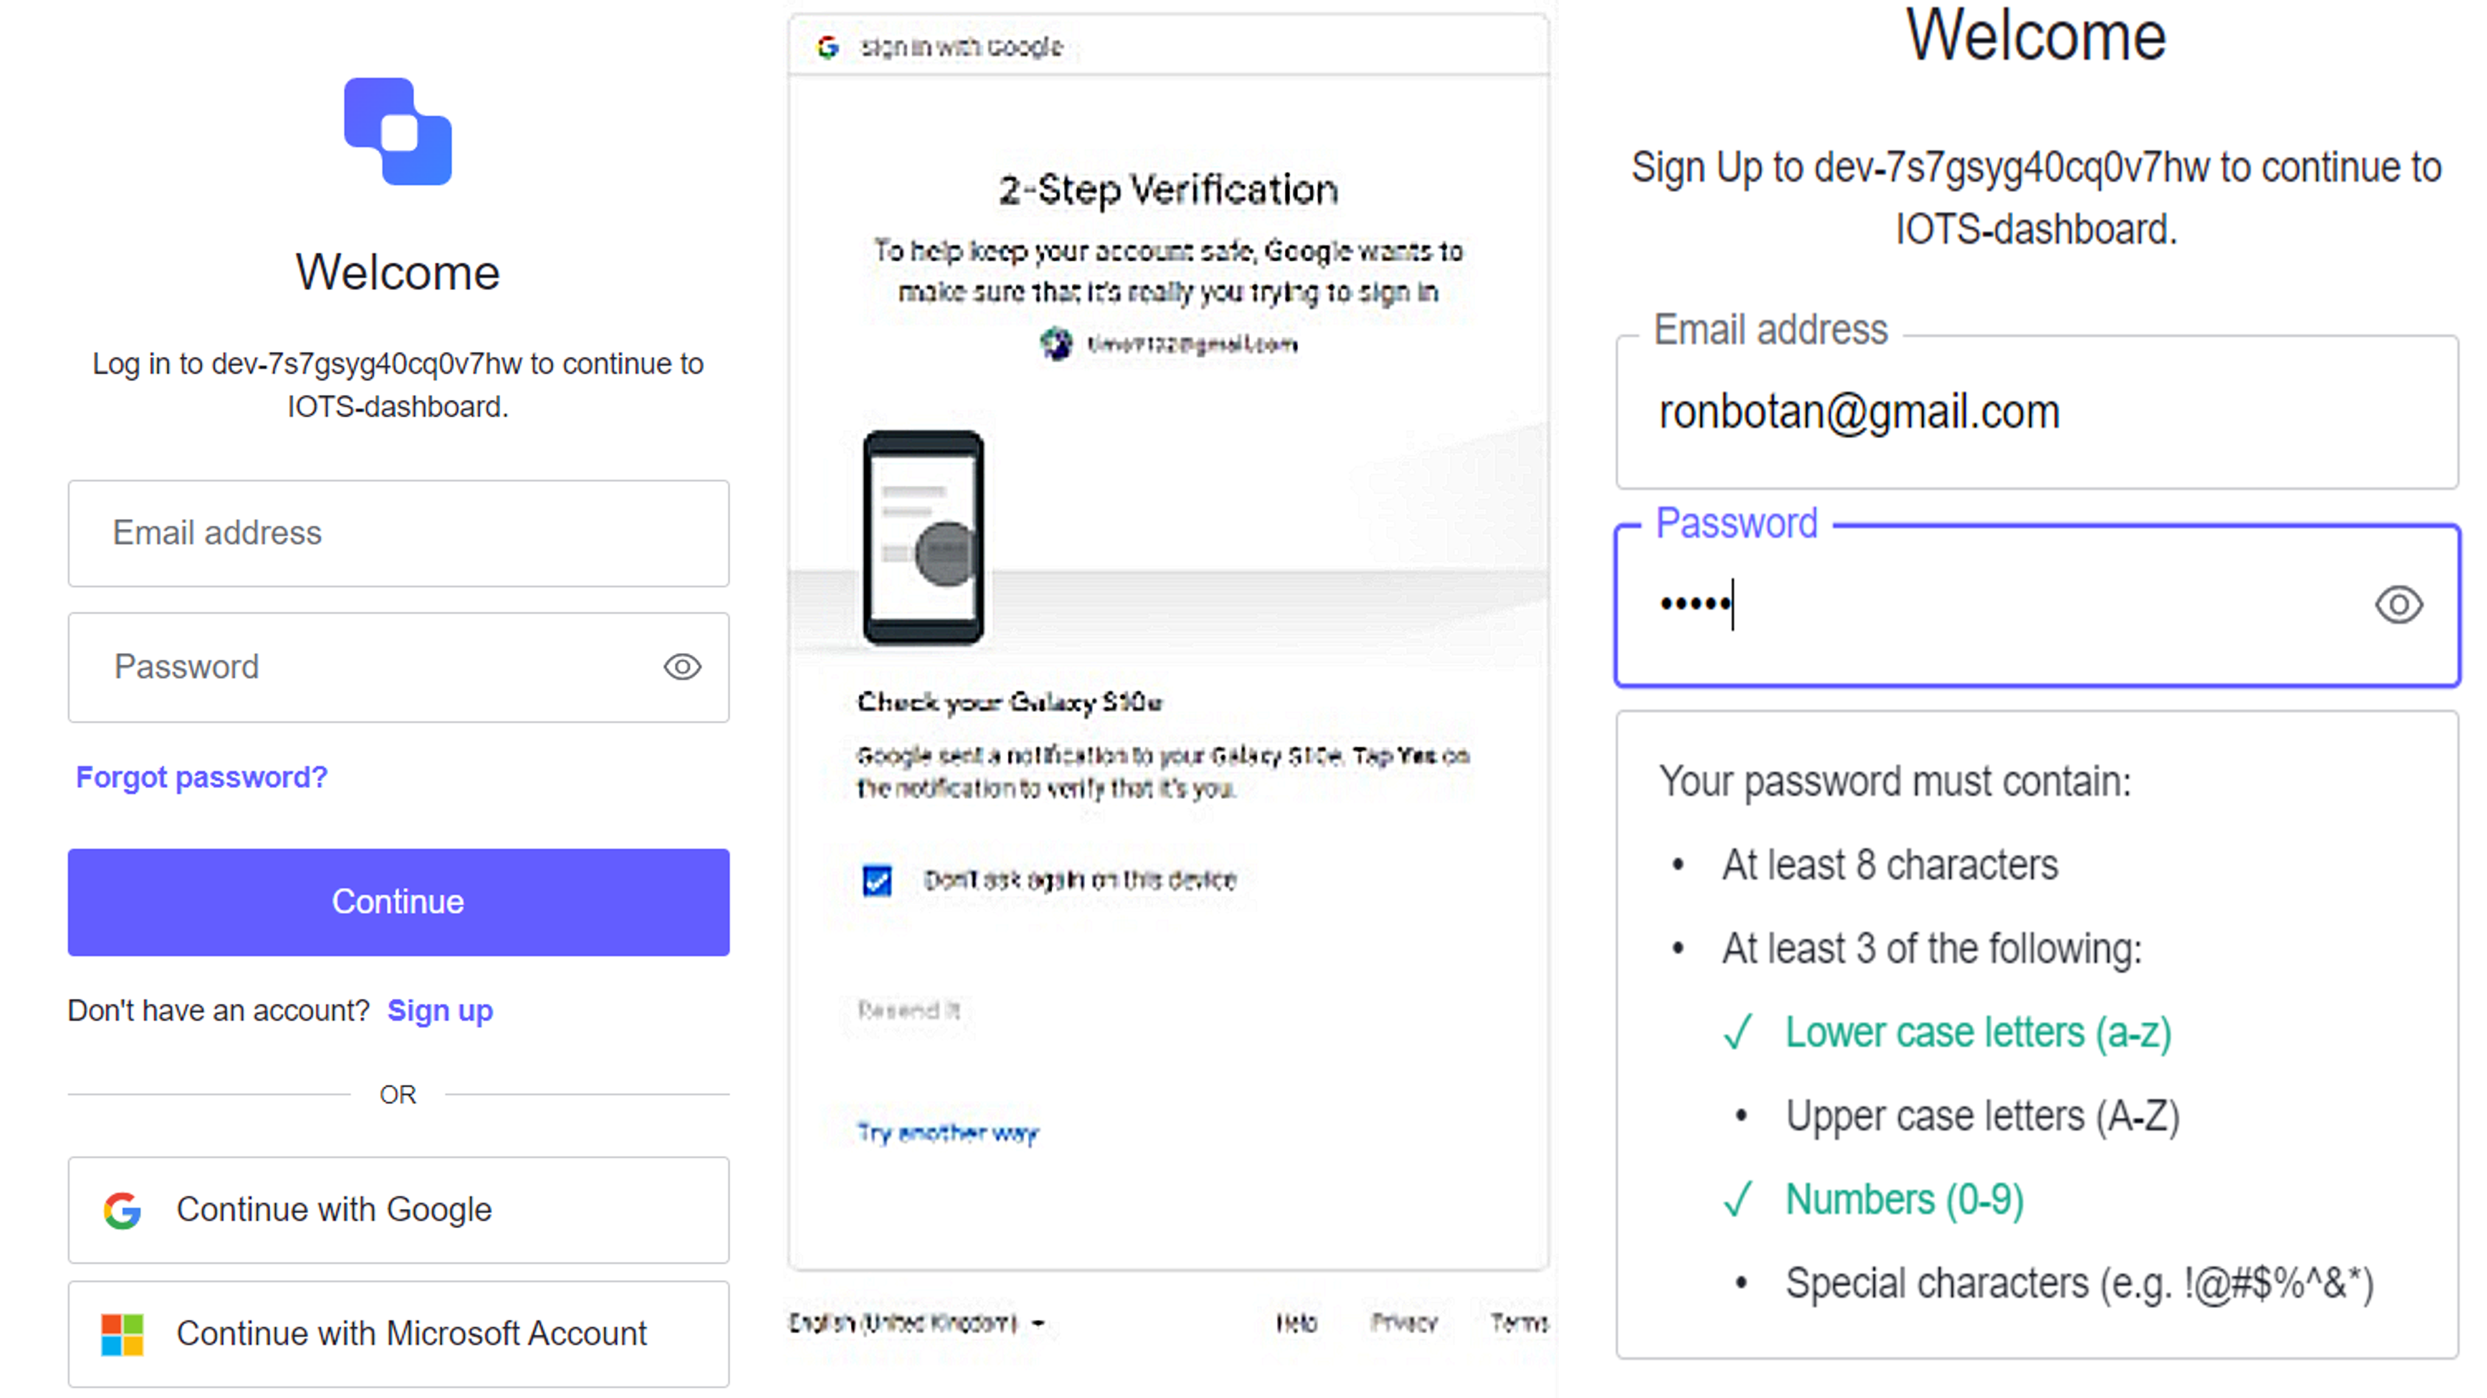
Database attack
vulnerabilities
dread
Breach of administrator account credentials. With a breached administrator account, the threat actor would have full access to the database and information of all the end users and customers.
Damage – 3
Reproducibility – 3
Exploitability – 3
Affect Users – 3
Discoverability – 1
mitigation
In order to reduce the chances of our Administrator account falling in the wrong hands, we set up several precautions.
Social Logins
2 Factor Authentication
Strong Password Requirements
Added Feature:
Data stored on Mongo does not include PIIs

Slide 15
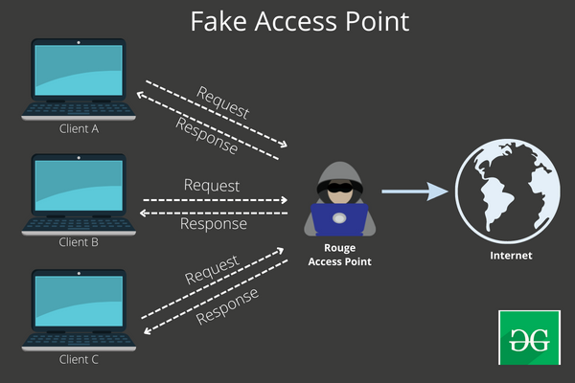
Security Testing
Method 1: DDoS
Method 2: MITM
Distributed Denial of Service
Access the network of the target device
Identify the target device
Perform the attack
Convert the device into a Zombie (Alternative)
Man in the Middle attack
Identify the network credentials of the target device
Create a fake Access Point
Analyze & Decrypt Transmissions

Slide 16
DEMO

